Slide 1
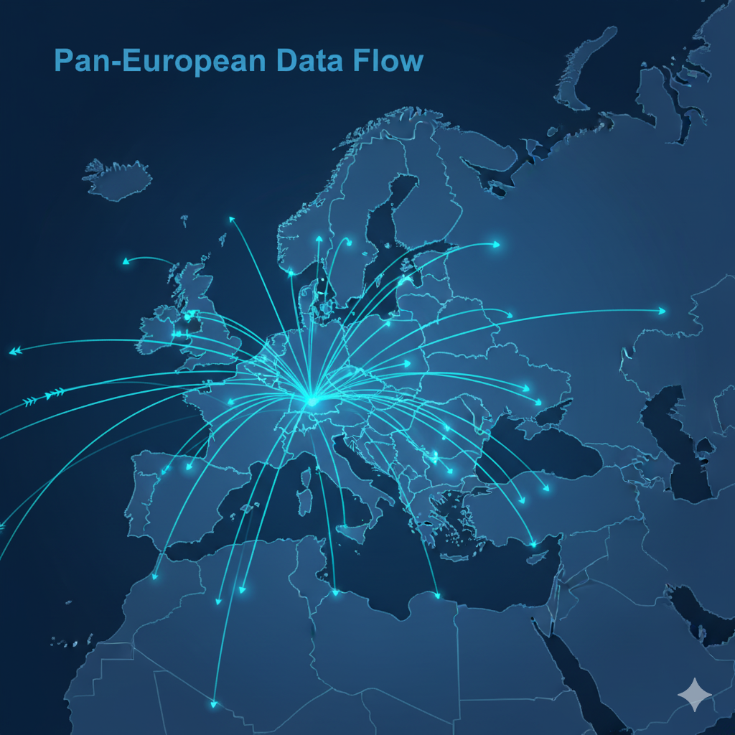
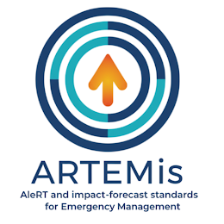


AleRT and impact-forecast standards
for Emergency Management
Grant: €3.14M
36 Months | 2025–2028
16 Partners | 8 Countries
HORIZON EUROPE
HORIZON-CL3-2024-DRS-01 | Innovation Action
This project has received funding from the European Union's
Horizon Europe research and innovation program under grant agreement No 101225852.

Slide 2






The Challenge
Why ARTEMis is needed
Europe's emergency management landscape is fragmented. Alert systems, impact forecasting protocols, and civil protection frameworks vary widely — creating critical gaps when natural disasters strike.
Fragmented Systems
Assessment Gaps
Capacity Disparities
No Unified Risk Awareness
No harmonised protocols across EU member states for alert and impact forecasting
Incomplete vulnerability & exposure mapping impairs timely civil protection responses
Wide variation in stakeholder preparedness, training, and emergency response capacity
Citizens & authorities lack standardised tools to visualise and act on local disaster risk
Project No. 101225852 | Funded by the European Union

Slide 3
Project Vision
ARTEMis will pave the way towards a new era of harmonised, standardised protocols, tools and procedures for emergency management and risk awareness at pan-European scale.
6 INNOVATION PILLARS
01
Assessment & Analysis
02
Integrated Framework
03
Harmonised Protocols
Comprehensive mapping of existing alert & impact forecasting systems across EU
Collaborative framework leveraging Copernicus Emergency Management Service
Standardised methods for vulnerability, exposure and alert dissemination
04
Implementation & Testing
05
Knowledge Transfer
06
Risk Awareness
Validation in disaster-prone regions via tabletop and full-scale exercises
Workshops, training & webinars for ongoing EU-wide capacity building
Innovative visualisation tools and public campaigns for EU citizens
Project No. 101225852 | Funded by the European Union

Slide 4
Work Packages
WP1
Project Management
Lead: ROA
M1–36
WP2
Assessment & Analysis of Existing Systems
Lead: CMCC
M1–6
WP3
Integrated Emergency Management Framework
Lead: ITML CY
M5–30
WP4
Harmonisation of Alert & Impact Forecasting
Lead: ASRO
M5–30
WP5
Validation, Testing & Impact Assessments
Lead: NOA
M7–36
WP6
Knowledge Transfer & Capacity Building
Lead: EENA
M3–36
WP7
Dissemination, Communication & Exploitation
Lead: CMCC
M1–36
Project No. 101225852 | Funded by the European Union

Slide 5
Consortium
16 partners across 8 European countries — Total budget: €3,486,602
GR
ROA
IT
CMCC
CY
ITML CY
GR
STWS
Perifereia Attikis
Euro-Mediterranean Centre on C
IOTAM Internet of Things Appli
Satways Security Services
GR
NOA
DE
Fraunhofer
RO
ASRO
BE
EENA
National Observatory of Athens
Fraunhofer Gesellschaft
Assoc. de Standardizare din Ro
European Emergency Number Asso
IT
OGS
GR
EDGE
ES
MITIGA
ES
Meteocat
Ist. Naz. di Oceanografia e di
Edge in Earth Observation Scie
Mitiga Solutions SL
Servei Meteorologic de Catalun
IT
IME
AT
GSA
SI
ARSO
FR
SIS2B
ItaliaMeteo — Nat. Meteorology
GeoSphere Austria
Agencija Republike Slovenije z
Service Départ. d'Incendie H-C
Project No. 101225852 | Funded by the European Union

Slide 6
Timeline & Budget
Oct 2025 – Sep 2028
PROJECT TIMELINE
Oct 2025
Start
M6
Assessment
Complete
M18
Framework v1
Delivered
M30
Harmonisation
Complete
Sep 2028
End
WP2: Assessment
WP3+WP4: Development
WP5: Validation
BUDGET OVERVIEW
€3.49M
€3.14M
€2.52M
100%/70%
Total Eligible
Costs
Maximum
EU Grant
Initial
Prefinancing
Funding Rate
Non-profit/Profit
Project No. 101225852 | Funded by the European Union

Slide 7




Expected Impact
Pan-European Harmonisation
Copernicus Integration
Standardised alert & impact forecasting protocols adoptable across all EU member states and regions
Seamless leveraging of Copernicus Emergency Management Service and Earth Observation capabilities
Resilience Enhancement
Capacity Building at Scale
Stronger civil protection through validated frameworks tested in real disaster-prone territories
Training materials, multilingual resources and workshops for emergency professionals EU-wide
Risk Awareness for Citizens
Institutional Collaboration
Innovative tools & public campaigns to improve local risk preparedness and community resilience
Bridges between European, national, regional & local emergency authorities for unified response
Project No. 101225852 | Funded by the European Union

